Slide 1

Lecture 24: Multiprocessor Scheduling
Deepak Gangadharan (Taken from slides by Dr. Mitra Nasri from TU Delft) Link: http://www.st.ewi.tudelft.nl/mitra/teaching/rts/2019/

Slide 2
Assumptions
Identical multicore systems (all cores are the same)
WCET of each task is a sound upper bound on the actual execution time of the task for any possible co-running tasks and any scenario
Each task has one sequential code segment

Slide 3
Classification of multiprocessor scheduling algorithms
Job-level dynamic-priority (JLDP) scheduling Each job has a varying priority
Dynamic
Job-level fixed-priority (JLFP) scheduling Each job has a fixed priority
Job static
Fixed-priority scheduling Each task has a fixed priority
Task
static
None
Partial
Full
Partitioned Scheduling Task cannot migrate between cores
Cluster Scheduling Some of the tasks can migrate between some pre-specified cores
Global Scheduling Any task is allowed to migrate between cores
Semi=Partitioned Scheduling Some of the tasks can migrate between cores

Slide 4
Partitioned Scheduling
Each processor manages its own ready queue
Processor for each task is determined offline
Processor cannot be changed at runtime

Slide 5
Global Scheduling
System manages a single queue of ready tasks
Processor for each task is determined at runtime
During execution, a task can migrate to another processor

Slide 6
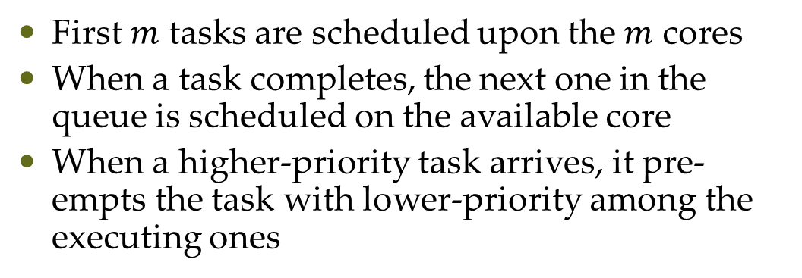
Global Scheduling
Global queue
(ordered according to a given policy)
First $m$ tasks are scheduled upon the $m$ cores
When a task completes, the next one in the queue is scheduled on the available core
When a higher-priority task arrives, it pre-empts the task with lower-priority among the executing ones
As a result, tasks may MIGRATE
between cores

Slide 7
Example: Global Rate Monotonic
What will be the schedule of these tasks on a multicore platform with 3 cores
Is this task set feasible?
Yes

Slide 8
Example: Other Global Scheduling Policies

Slide 9
Example: Other Global Scheduling Policies

Slide 10
Example: Other Global Scheduling Policies

Slide 11
Example: Global Scheduling of DAGs

Slide 12
Global Scheduling
Work-conserving scheduler
No processor ever idles when a task is ready to execute
Non-work-conserving scheduler
A processor may be left idle even if there are ready jobs

Slide 13
Global Scheduling: Advantages
Allows parallel execution
Load balancing between the cores (as jobs are dispatched on idle cores)
Easier re-scheduling (dynamic loads, selective shutdown, etc.)
Lower average response time (known result from queuing theory)
More efficient reclaiming and overload management
Number of preemptions

Slide 14
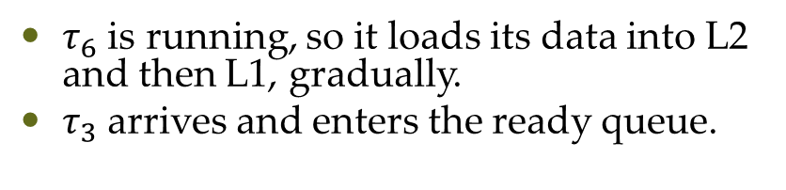
Global Scheduling: Disadvantages
Overheads
Obvious overheads Task migration between cores
$τ_{6}$ is running, so it loads its data into L2 and then L1, gradually.
$τ_{3}$ arrives and enters the ready queue.
Why task migration has a big
impact on task’s execution time
Ready queue

Slide 15
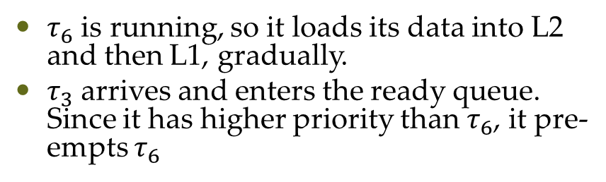
Global Scheduling: Disadvantages
Overheads
Obvious overheads Task migration between cores
$τ_{6}$ is running, so it loads its data into L2 and then L1, gradually.
$τ_{3}$ arrives and enters the ready queue. Since it has higher priority than $τ_{6}$, it pre-empts $τ_{6}$
Why task migration has a big
impact on task’s execution time
Ready queue

Slide 16
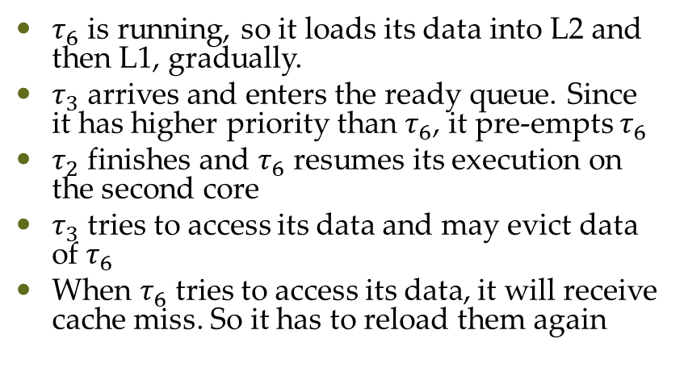
Global Scheduling: Disadvantages
Overheads
Obvious overheads Task migration between cores
$τ_{6}$ is running, so it loads its data into L2 and then L1, gradually.
$τ_{3}$ arrives and enters the ready queue. Since it has higher priority than $τ_{6}$, it pre-empts $τ_{6}$
$τ_{2}$ finishes and $τ_{6}$ resumes its execution on the second core
$τ_{3}$ tries to access its data and may evict data of $τ_{6}$
When $τ_{6}$ tries to access its data, it will receive cache miss. So it has to reload them again
Why task migration has a big
impact on task’s execution time

Slide 17
Global Scheduling: Disadvantages
Overheads
Obvious overheads Task migration between cores
Non obvious overheads Large Scheduling overhead Whenever the task on a core completes, it calls the scheduler function. So, multiple scheduler functions can run at the same time if multiple tasks finish at the same time. Since each scheduler function wants to access the global ready queue, which is a global variable, it must be protected by semaphores or locks. Therefore, scheduler functions called by different cores can frequently block each other

Slide 18
Global Scheduling: Disadvantages
Dhall’s Effect
Regardless of the number of cores in the system, we may not be able to find a feasible schedule for the tasks even if the utilization is just about 1

Slide 19
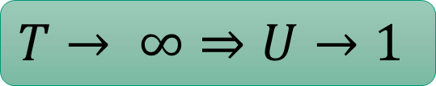
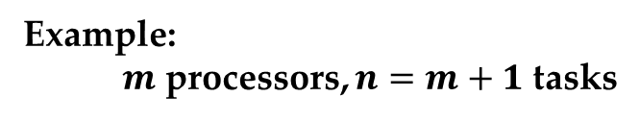
Dhall’s Effect (on any global work-conserving policy including global EDF)
Example: $m$ processors, $n=m+1$ tasks
$$T→ ∞⇒U→1$$
This task set is feasible by partitioned
scheduling

Slide 20
Negative results about global scheduling
Weak theoretical framework
Unknown critical instant
Global-EDF is not optimal
Any global job-level fixed-priority (G-JLFP) scheduler is not optimal
Optimal algorithms exist only for sequential implicit deadline tasks
Many sufficient tests (most of them incomparable)

Slide 21
Partitioned Scheduling
The scheduling problem is

Slide 22
Possible Partitioning Choices
Partition by information sharing requirements
Partition by functionality
Use the least possible number of processors or run at the lowest possible frequency
Depends on considerations like fault tolerance, power consumed, temperature, etc.
Partition to increase schedulability → Real-Time Systems research has focused on this extensively
Might not be good
for schedulability

Slide 23
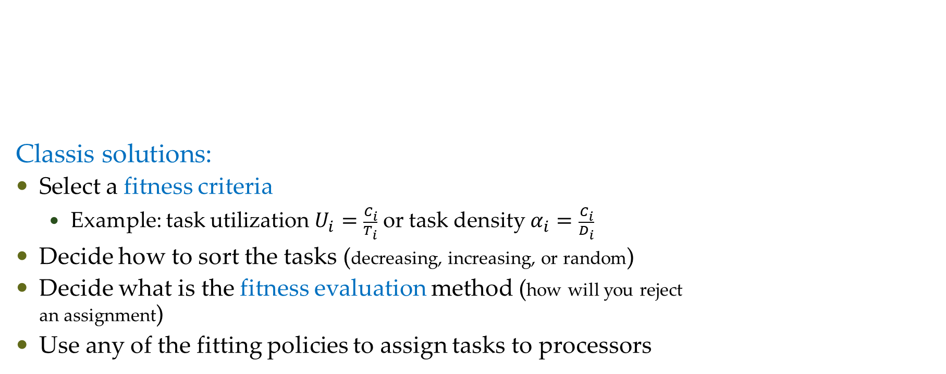
Classic partitioning algorithms for real-time systems
Classis solutions:
Select a fitness criteria
Example: task utilization $U_{i}=\frac{C_{i}}{T_{i}}$ or task density $α_{i}=\frac{C_{i}}{D_{i}}$
Decide how to sort the tasks (decreasing, increasing, or random)
Decide what is the fitness evaluation method (how will you reject an assignment)
Use any of the fitting policies to assign tasks to processors

Slide 24
Partitioning Heuristics
First Fit (FF)
Place each item in the first bin that can contain it
Best Fit (BF)
Place each item in the bin with the smallest empty space
Worst Fit (WF)
Place each item in the used bin with the largest empty space, otherwise start a new bin
Next Fit (NF)
Place each item in the same bin as the last item. If it does not fit, start a new bin

Slide 25
Comparison
Suppose the current situation is represented in blue, the latest item was put in bin 2, and a new item of size 2 arrives:

Slide 26
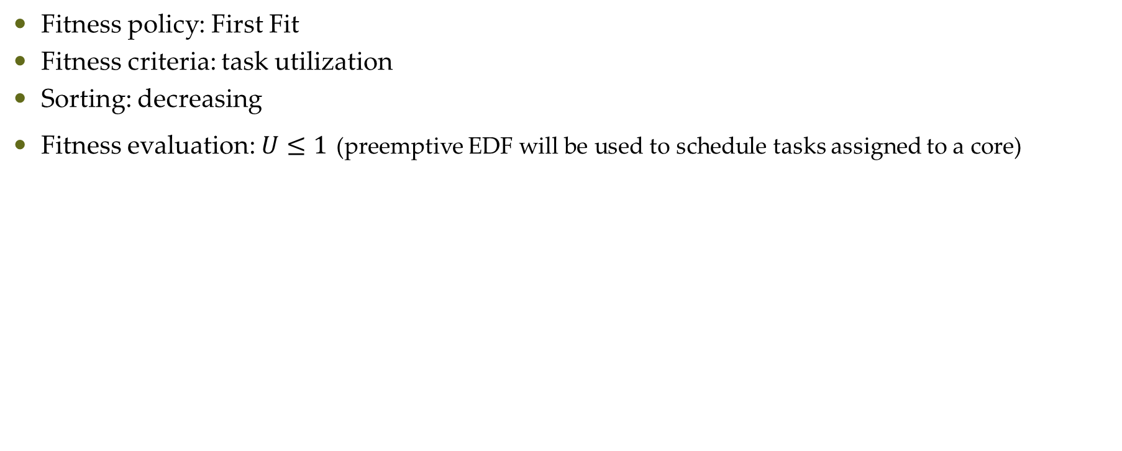
Example
Fitness policy: First Fit
Fitness criteria: task utilization
Sorting: decreasing
Fitness evaluation: $U≤1$ (preemptive EDF will be used to schedule tasks assigned to a core)

Slide 27
Observations
NF has poor performance since it does not exploit the empty space in the previous bins
FF improves the performance by exploiting the empty space available in all the used bins
BF tends to fill the used bins as much as possible
WF tends to balance the load among the used bins

Slide 28
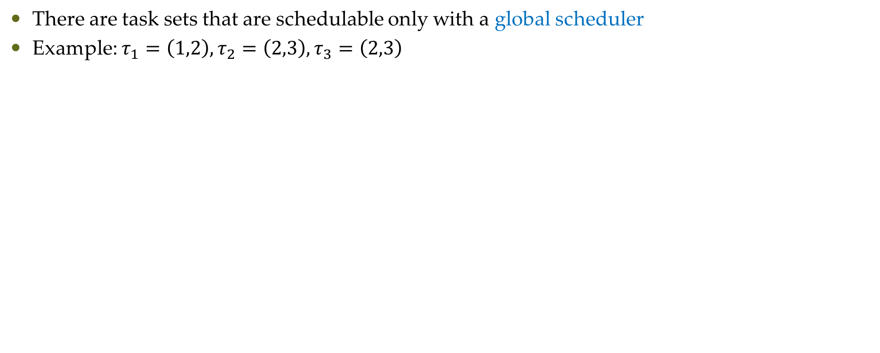
Global vs Partitioned Scheduling
There are task sets that are schedulable only with a global scheduler
Example: $τ_{1}=\left(1,2\right),τ_{2}=\left(2,3\right),τ_{3}=\left(2,3\right)$

Slide 29
Global vs Partitioned Scheduling
There are task sets that are schedulable only with a partitioned scheduler
Example for 2 cores (assume that each core is scheduled with EDF)

Slide 30
Global vs Partitioned

Slide 31
Semi-partitioned scheduling
Tasks are statically allocated to processors, if possible
Remaining tasks are split into chunks (subtasks), which are allocated to different processors

Slide 32
Clustered scheduling
A task can only migrate within a predefined subset of processors (cluster)

Slide 33
Questions?

